Slide 1

Graph Database With

Slide 2
Table of contents
What is graph database?
What is Neo4j
Modeling
Querying with Cypher
Demo
Let’s get deeper
Common use cases
Advantages and drawbacks
Perspectives

Slide 3
What is Graph Database?

Slide 4
What is Graph Database? A NoSQL Database
One of the many NOSQL databases:
Document
Key value
Column
Time series
Graph

Slide 5
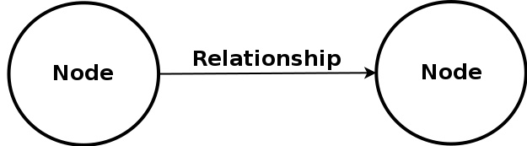
What is Graph Database? Elements of a graph database
It’s all about nodes and relationships

Slide 6
What is graph database?
Different kind of graph databases
NATIVE
Engine:
Index-free adjacency
Storage:
Reflects graph structure
NON NATIVE
Engine:
Index based
Storage:
Non-graph structure (SGBDR, Document Model, Key-value, etc.)

Slide 7
What is Neo4j?

Slide 8
What is Neo4j?
Brief history
2000: First prototype
2010: Neo4j 1.0 release
-> embedded only
2013: Neo4j 2.0 release
-> server
-> cypher
2016: Neo4j 3.0 release
-> BOLT
-> Stored procedure
-> No limits

Slide 9
What is Neo4j?
Brief description
Native graph storage
Native graph processing
ACID
2 products:
Database
Browser
2 versions (with same performance):
Community Edition (open source)
Enterprise Edition (non-free, HA, backup without stopping server)

Slide 10
Modeling

Slide 11
Modeling Elements of a graph database in Neo4j
It’s all about nodes and relationships
Nodes have:
Labels
Properties
Relationships have:
One type
Properties

Slide 12
Modeling
Relational vs graph
RELATIONAL
Understand entities in domain and how they interrelate
Define relationship between entities
Normalization
Denormalization
GRAPH
Understand entities in domain and how they interrelate
Enrich this domain model

Slide 13
Querying with Cypher

Slide 14
Modeling & Querying: Cypher
Introduction
An ASCII art query language
Node representation: (identifier:Label)
Relationship representation: -[identifier:TYPE]->
Ex: Trinity loves Neo who works for MetaCortex
(Trinity)-[:LOVES]->(Neo)-[:WORKS_FOR]->(MetaCortex)

Slide 15
Querying with Cypher
Main clauses (1)
MATCH
-> Catches nodes from which we are going to traverse the graph
RETURN
-> Returns the query result
WHERE
-> Filters query result
WITH
-> Chains subsequent parts of the query

Slide 16
Querying with Cypher
Main clauses (2)
CREATE
-> Creates an element (node or relationship) and returns it
MERGE
-> Creates an element if it doesn’t exists and returns it or only returns it if it exists
SET
-> Used to set properties on nodes and relationships (beware of NULL)
DELETE
-> Deletes an element (node, relationship or property)

Slide 17
Querying with Cypher
Evolution
Evolves to OpenCypher
OpenCypher is intended to be used by all Graph Database system
Already supported by Apache Spark and Oracle

Slide 18
Quick Demo
Notes:
To show in demo:
Node creation (CREATE, MERGE)
Relationship creation (MERGE)
Querying graph (MATCH, RETURN)
Pattern matching( [*..2])
Delete node / relationship (DELETE)
Move relationship
Transform node property into node+relationship

Slide 19
Let’s get deeper
Notes:
To show in demo:
Node creation (CREATE, MERGE)
Relationship creation (MERGE)
Querying graph (MATCH, RETURN)
Pattern matching( [*..2])
Delete node / relationship (DELETE)
Move relationship
Transform node property into node+relationship

Slide 20
Let’s get deeper
API
Database can be query via:
REST API
Bolt (since 3.0)
Binary
Secured
If performance aren’t satisfying, it is still possible to develop Java methods to address specific problems

Slide 21
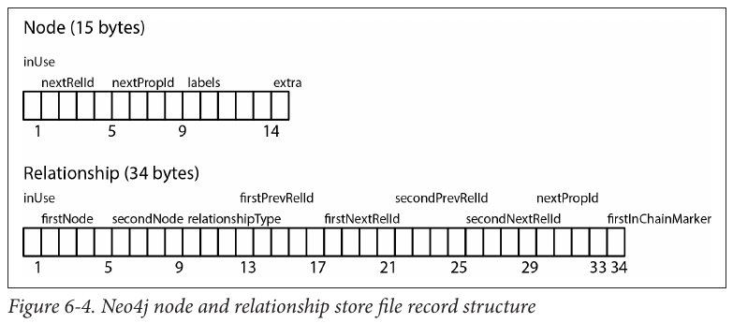
Let’s get deeper
Storage

Slide 22
Let’s get deeper
Sharding
Sharding is not possible in Neo4j (and in graph database generally)
-> Neo4j answer:
- Cache sharding: caches part of or all of the graph in RAM

Slide 23
Let’s get deeper
Scaling up
Neo4j bottlenecks are disk I/O and graph caching, then:
RAM is more important than CPU (page cache)
Faster disks (SSD)
At the final talk at Graph Connect 2016, Jim Weber (Neo4j Chief scientist) talk about graph caching and how it will be greatly improve by using RAFT.

Slide 24
Let’s get deeper
Scaling out
Exclusive territory of the Enterprise Edition
Neo4j can work with cluster:
Easy configuration
master/slave election can be configured
Synchro between masters and slaves can be configured too (trade off between speed and delay)
Branching could save your data

Slide 25
Let’s get deeper
Stored procedures
Since version 3.0.0 (2016/04/26), store procedures are available in Neo4j
Written in Java
Stored in plugins/ directory
Apoc procedures! https://github.com/neo4j-contrib/neo4j-apoc-procedures
Connect to RDBMS
Meta graph
Load from json, xml, etc.
Geocode
...

Slide 26
Let’s get deeper
Query planner
Analyzes the query and choose the best way to perform it
To watch it in action:
EXPLAIN: profiling without query execution
PROFILE: profiling with query execution
Results aren’t in time but in db hits as time depends on the machine
In terms of time:
All nodes scan > Node by label scan > Node Index Seek

Slide 27
Let’s get deeper
Language drivers
Since version 3.0, drivers are developped by Neo4j.
All languages share the same logic:
from neo4j.v1 import GraphDatabase, basic_auth driver = GraphDatabase.driver("bolt://localhost", auth=basic_auth("neo4j", "<password>")) session = driver.session() session.run(insert_query, parameters={"pairs": data})
Drivers available for: Java, Python, Javascript, Ruby, C#, PHP Community is working on driver for GoLang, R (drivers exist for neo4j 2.x)

Slide 28
Let’s get deeper
Arborescence
Want to see the arbo?
bin: neo4j executables
certificates: certificates used by BOLT
conf: neo4j configuration files
data: databases storage
import: where to store the csv file to load via LOAD CSV
logs: application log
lib: Neo4j libraries
plugins: contains stored procedures / plugins
run: contains the current process pid

Slide 29
Let’s get deeper
Ecosystem
Works fine with:
Spark
MongoDB
Cassandra
ElasticSearch
Docker
...
See: https://neo4j.com/developer/ecosystem/

Slide 30
Common use cases

Slide 31
Common use cases
Social network
First, a little example with two companies and their employees and skills.
Triadic closures
“If a node A has strong relationships with node B and node C, then B and C have at least a weak, potentially strong, relationship between them.”

Slide 32
Common use cases
Itinerary
Example: parisian metro
How to find the quickest route between two stations?
Manage closed stations
Use:
Classic path finding
shortestPath
apoc.djikstra

Slide 33
Common use cases
Recommendation
Example: amazon-like online shop
Recommendation based:
- on what other customers buy
- on customer profile
Clustering:
Setup
Dividing for better recommendation

Slide 34
Common use cases
Access Management
Example: A company where we want to manage access management to different kind of resources (level in the building, documents, computer, etc.)
Get the accessible resources for a given person
Update with new access right
Temporary accesses

Slide 35
Advantages / Drawbacks?

Slide 36
What is Graph Database?
Advantages
FAST & LIGHT
Index-free adjacency
Native processing / storage
No more JOIN pain
Light storage

Slide 37
What is Graph Database?
Advantages
FLEXIBLE / AGILE
Schema-free / easy evolution
Can evolve within business demands
Iterative evolution without impact

Slide 38
What is Graph Database?
Advantages
EASY TO IMPLEMENT / READY FOR PRODUCTION / RELIABLE
Clustering (in Enterprise Edition)
No database limit
Transactions
Hot backups (in Enterprise Edition)
Branching

Slide 39
What is Graph Database?
Drawbacks
No IF!
Date is not a native format
Where are mys users?
Schema free (Know your data and how to architect them)
It’s not a miracle solution

Slide 40
Perspectives?

Slide 41
Perspectives
What can Neo4j do for Kwanko
Two main problems of Kwanko (especially Netaff):
[Employees]
No tools for good commercial advice
No statistics of what works well, how, when
[Client]
Lack of useful statistics
No advices
Platform/product non attractive for tech companies

Slide 42
Perspectives
What can we do with Neo4j
[Employees]
Developp a “consulting tool”:
Client profiling
Program/Site profiling
Coupled with statistics:
fine grained recommendation
Profile statistics
[Client]
Provide recommendation when creating slot / applying for a program/ etc.
Provide webservices to use recommendations tools on their own platform

Slide 43
Perspectives
How can we get more tech companies
Start a Google-like product developpment life cycle:
Developpment / Unit tests / Documentation
Intern communication
Intern use (client pov: better services, advices,etc. )
Communication! (how this new product helps us to make our clients business grow)
Release to public
BEWARE OF THE MACHINE ONCE STARTED

Slide 44
(I)-[:THANKS {for:”attention”}]->(You)

